Slide 1
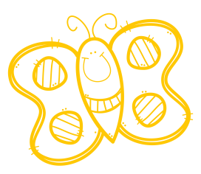
BUTTERFLY COUNT
COUNT AND WRITE THE NUMBER OF BUTTERFLYS IN EACH SQUARE

